Slide 1
Teacher Retirement System
Issues and Challenges for the 82nd Regular Session
Presentation to the TASSCUBO Winter Conference
February 21, 2011

Slide 2
Topics for Discussion
Pension Trust Fund Status
Budget Issues for FY 2012-13
TRS-Care and TRS-ActiveCare
TRS Legislative Issues
TRS Administrative Initiatives
Board of Trustees Elections
Questions and Answers

Slide 3
Pension Trust Fund Status
The trust fund has recovered virtually all losses from the previous two years after hitting a low of approximately $70 billion in February 2009. The fund’s current market value has rebounded to about $106 billion.
TRS ranked #1 in its peer group for annual returns as of 9/30/10 and has performed exceptionally well so far this year. The economic forecast for the remainder of this year is positive.
TRS’ latest actuarial valuation, as of Aug. 31, 2010, reports relatively little change from the previous year’s valuation. The trust fund’s unfunded liability is now $22.9 billion with a funded ratio of 82.9 percent. The next valuation will be done as of 2/28/11 with results available by the third week in March.

Slide 4
Pension Trust Fund Status
TRS actuarial valuations mitigate short-term fluctuations in rates of return through a process called “smoothing.” This allows the impact of annual gains and losses to be spread out over a five-year period.
If the current contribution policy continues, the trust fund is projected to have sufficient assets to make benefit payments through 2072, an increase of 14 years over the last valuation.
Fund contributions for FY 2010-11 are set at 13.044 percent, but could be reduced for FY 2012-13. These contribution levels are not adequate to fund longer-term TRS liabilities unless investment returns exceed the assumed rate of return of 8% over time.

Slide 5
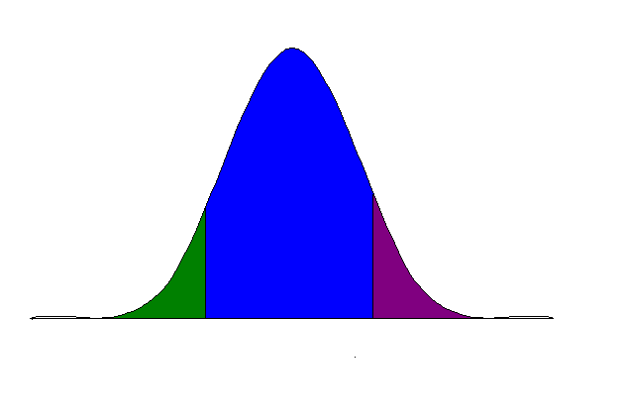
Diversified Portfolio Review
Overview of Results as of 09/30/10
Stable Value
20%
Policy weights:
15% - Long Treasuries
4% - Hedge Funds
1% - Cash
Global Equity
60%
Policy weights:
22% - US Large Cap
5% - US Small Cap
15% - Non- US Developed
10% - Emerging Market Equities
8% - Private Equity
Real Return
20%
Policy weights:
8% - TIPS
2% - Commodities
2% - REITS
8% - Real Estate/Real Assets
Global Equity
60%
US Large Cap
US Small Cap
Non- US Developed
Emerging Market Equities
Private Equity
Q310 | 4.8% | 12.8% | 4.9% | 9.6%
1 Year | 14.9% | 12.4% | 8.9% | 12.6%
Ending Value | $20.1B | $62.2B | $18.0B | $100.3B
Period | Stable Value | Global Equity | Real Return | Total Trust
Strong third quarter (up 9.6%)
Solid year (up 12.6%)
Trust Performance generally consistent with Economic Regime
Peer Results: 1st Percentile
Source: State Street Bank.

Slide 6
TRS Budget Issues for FY 2012-13
State budget writers are trying to address a budget shortfall that ranges from $15-$27 billion depending on assumptions.
TRS requested funding to maintain the state contribution rate of 6.644% and member rate of 6.4%. Also assumed covered payroll growth of 5% per year for Public Education and 6% per year for Higher Education.
House and Senate appropriations bills as introduced assume a state contribution rate of 6.0% (constitutional minimum) and member rate of 6.4% (statutory change is assumed). Both also assume less payroll growth.
House and Senate bills also assume a state contribution to TRS-Care of 0.5%, down from 1.0% currently in statute.

Slide 7
TRS Budget Issues for FY 2012-13 (Cont’d)
A new rider has been added to the House and Senate bills related to retirement contributions funded by general revenue for public community/junior colleges.
The rider has two provisions:
  A limit on the use of General Revenue for retirement contributions to 6% of each district’s unrestricted General Revenue appropriations.
  A reference to potential legislation by the Eighty-second Legislature relating to state retirement contributions for public community/junior colleges.
TRS is still trying to gain an understanding of the actual impact of this rider.

Slide 8
TRS-Care and TRS-ActiveCare Issues
TRS-ActiveCare funding from state and districts is a fixed amount that has not changed since the program was created ($225 combined per member per month).
TRS board voted to increase TRS-ActiveCare premiums by 9.5% and made plan design changes at the February 2011 board meeting.
TRS-Care currently has a positive balance of nearly $800 million, but will be depleted as program costs exceed revenues.
Due to the relative health of the fund, there have been no premium increases since FY 2005.
Depletion date depends on state contribution assumptions.
TRS board will not consider other options for TRS-Care until after the legislative session.

Slide 9
Depletion Date Accelerates at 0.5%
Notes:
Based on current projections and assuming no significant changes are made TRS-Care will run out of money by 8/31/2015.
Funding comes from retiree premiums, Medicare Part D and a portion based on 2.2% of payroll (1.0%-state, 0.65%-active members & 0.55%-districts).
To make TRS-Care actuarially sound would require contributions of 7.12% of payroll. This would cover normal cost of 3.68% and amortize the unfunded actuarial accrued liability of $23.6 billion over 31 years.

Slide 10
TRS Legislative Issues
Investment authority bills
  Sunset on use of external managers and derivatives
  Cap on hedge funds
Omnibus clean-up
Standardized purchase of service credit
Standardize the benefit year
Simplify Return-to-Work program
All bills are designed to eliminate exceptions, enhance our ability to generate positive returns, and improve efficiency and service delivery.
Other issues: pension sustainability and board composition

Slide 11
TRS Administrative Initiatives
Investment Resources
System Modernization
Rules Convention
Forms Review
Enhanced communications
  Streamed board meetings
  Member outreach
  MyTRS
  Issue-oriented videos
  User friendly brochures
  Web self service

Slide 12
Board of Trustees Spring Elections
The Active Higher Education member ballot will have three candidates: Joe Angulo (UT-Pan American); Thelma (Karen) Charleston (Prairie View A&M); and Julien Devereux (UT-Austin).
The Retiree member ballot will also have three candidates: George Lynn Britton, Jr. (San Antonio); William Ishee (Spring); and Anita Palmer (Wichita Falls).
TRS will mail ballots and candidate information for both elections to all eligible voters by March 15.
The completed ballots must returned to TRS by April 30, 2011.
The governor will then select from the three candidates in each election to fill the two seats, which are both for six-year terms.

Slide 13
Questions?

